Slide 1
Analysis of Algorithms

Slide 2
To measure the performance of a data structure
We measure the performances of those algorithms that can be applied to the data structure.
An algorithm is a sequence of well-defined computational steps for completing a task.
Notes:
e.g. processor speed vs memory space
What factors can affect the actual run time of a program?
number of instructions executed per input
number of data items (size of input)
e.g. sorting 5 items vs 1000 items
contents of the input
e.g. integer data vs more complex structure
optimization made by compiler
e.g. compiler may put frequently used variables into registers
speed of various instructions in the machine used

Slide 3
The two main tasks in the study of algorithms:
Design - devising an algorithm that correctly solves a given problem.
Algorithm design is a creative process. It’s more art than science.
Some well known techniques for algorithm design:
Divide and conquer method
Greedy technique
Backtracking
Dynamic programming
Analysis - determining the correctness and efficiencies of a given algorithm.
Notes:
e.g. processor speed vs memory space
What factors can affect the actual run time of a program?
number of instructions executed per input
number of data items (size of input)
e.g. sorting 5 items vs 1000 items
contents of the input
e.g. integer data vs more complex structure
optimization made by compiler
e.g. compiler may put frequently used variables into registers
speed of various instructions in the machine used

Slide 4
Algorithm efficiencies
Types of efficiencies
Time complexity: a measure of the amount of time required by an algorithm.
Space complexity: a measure of the amount of memory required.
Which measure is more important?
It often depends on the limitations of the technology and resources available.
Time-space trade-off.
Notes:
e.g. processor speed vs memory space
What factors can affect the actual run time of a program?
number of instructions executed per input
number of data items (size of input)
e.g. sorting 5 items vs 1000 items
contents of the input
e.g. integer data vs more complex structure
optimization made by compiler
e.g. compiler may put frequently used variables into registers
speed of various instructions in the machine used

Slide 5
Time Complexity Analysis
Objectives of time complexity analysis:
To determine the feasibility of an algorithm by estimating an upper bound on the amount of time required.
To compare different algorithms before deciding which one to implement.
Time complexity analysis for an algorithm is independent of the programming language and the machine used.
The time complexity of an algorithm is expressed as a function of the size of the input.

Slide 6
Time Complexity Measurement
The uniform cost method
We assume that all basic operations such as additions, subtractions, and multiplications take the same amount of time.
Essentially the time complexity of an algorithm depends on the number of basic operations in an algorithm.

Slide 7
Example: To compute a^{n}
Algorithm I
p = 1;
for (i=0; i<n; ++i)
p *= a;
Algorithm II
p = 1;
e = a;
N = n;
while (N>0) {
if (N%2 != 0)
p *= e;
e *= e;
N /= 2;
}
Assume that n is13
Pass | 0
p | 1
e | a
N | 13
1
2
3
4
a
a
a⁵
a¹³
a²
a⁴
a⁸
a¹⁶
6
3
1
0

Slide 8
Types of Analysis
Worst-case analysis
Analyze running time as function of worst input of a given size.
Average case analysis
Analyze average running time over some distribution of inputs.
Amortized analysis
Worst-case bound on a sequence of operations.
Competitive analysis
Make quantitative statements about online algorithms.

Slide 9
Analyzing Algorithm I
p = 1;
for (i=0; i<n; ++i)
p *= a;
n passes
T₁(n) = 2 + 3n

Slide 10
Analyzing Algorithm II
Pass | 0 | 1 | 2 | 3 |  | k
N | n | n/2 | n/2² | n/2³ |  | n/2^{k}
p = 1;
e = a;
N = n;
while (N>0) {
if (n%2 != 0)
p *= e;
e *= e;
N /= 2;
}
Termination condition: N ≤ 0
When the loop stop n/2^{k} ≤ 0
That is n < 2^{k}
Thus, when the loop stops k > ⎡lg n⎤
So, there are ⎡lg n⎤+1 passes.
T₂(n) = 3 + 6 (⎡lg n⎤ +1)

Slide 11
Comparing T₁(n) and T₂(n)
T₁(n) = 2 + 3n T₂(n) = 3 + 6 (⎡lg n⎤+1)
n | 1 | 2 | 4 | 8 | 16 | 32
T₁(n) | 5 | 8 | 15 | 26 | 50 | 98
T₂(n) | 9 | 15 | 21 | 27 | 33 | 39

Slide 12
Asymptotic Analysis
Analyzing T(n) as n "gets large"
Example:
T(n) = 10 n³ + 123 n² + 986 n lg n
As n grows larger n³ grows faster than n² and n lg n. So, it determines the speed/order of growth of T(n).
Notationally, T(n) = O(n³).

Slide 13
Big-O : Formal Definition
T(n) is O(f(n)) if there exist positive constants c and n₀ such that T(n) < cf(n) for all n > n_{0.}
What does this mean? This gives an upper bound on T(n), for sufficiently large n.
Upper Bound
c*f(n)
T(n)
n₀
n
Don’t care

Slide 14
Big-O Analysis conti.
We want f(n) to be an easily recognized simple term (i.e. function).
We want a tightest (i.e. smallest) upper bound for our choice of f(n).

Slide 15
Example: To prove n²+10n = O(n²)
For n≥1,
n²+10n ≤ n²+10n²
≤ 11n²
We can take c=11 and n₀=1 to prove n²+10n = O(n²).
11*n²
n²+10n
n₀=1
n

Slide 16
Order arithmetic
O(cf) = O(f).
O(f + g) = O(max {f, g}).
O(f.g) = O(f).O(g).
(Drop constant)
(Use dominant term)
(Simplify individually)
Example:
O( (123n³ + 24n² + 120).(200 n lg n + 5n + 12) )
= O(123n³ + 24n² + 120).O(200 n lg n + 5n + 12)
= O(123n³).O(200 n lg n)
= O(n³).O(n lg n)
= O(n⁴ lg n)

Slide 17
Quizzes
True or false?
n = 1+1+1+…+1
O(n) = O(1+1+1+…+1)
= O(1)
Which one is correct?
If f(n) = n then
f(n) = O(n)
f(n) = O(n²)
F(n) = O(2^{n})
Notes:
Outer loop executes n/2 times
For each of these times, inner lop executes n^2 times, so the body of the inner loop
Is executed (n/2) * n^2 = n^2 / 2 times. So, it is O(n^2)

Slide 18
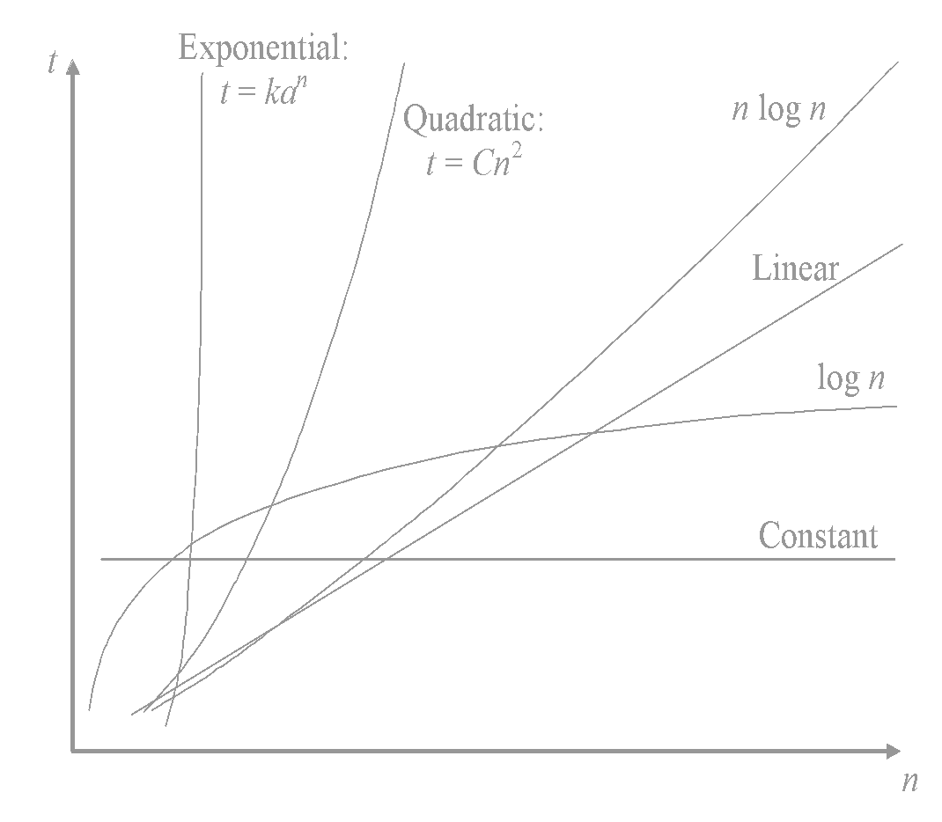
Examples of dominant terms
n^{1/2} dominates log₂(n)
n dominates n^{1/2}
n log₂(n) dominates n
n² dominates n log₂(n)
n^{m} dominates n^{k} when m > k
a^{n} dominates n^{k} for any a > 1 and k >= 0
That is,
1 < log₂(n) < n^{1/2} < n < n log₂(n) < n² <…< n^{m} < a^{n}
for a > 1 and m >2.

Slide 19
Example 1: worst case analysis
i = 1; s = 0;
while (i<n) {
s += i;
i *= 2;
}
Pass | 0 | 1 | 2 | 3 |  | k
i | 1 | 2 | 4 | 8 |  | 2^{k}
S | 0 | 1 | 3 | 7 |  | 2^{k}-1
From the termination condition i>=n
⇒ 2^{k} >= n
⇒ k > lg n
So, the time complexity is O(lg n)
Notes:
‹#›

Slide 20
Example 2: Nested loops
for (i = 1; i <= n; i++) {
for (j = 1; j <= n; j++) {
k = k+1 ;
}
}
outer loop
executed
n times
inner loop
executed
n times
constant time
Total time = c * n * n * = cn² = O(n²)

Slide 21
Example 3: nested loops
s = 0;
for (i = 0; i < n; i++) {
for (j = 0; j <= i; j++) { s += j;
}
}
The number of passes of the inner loop is i+1.
The total number of passes is
Σ_{i=0..n-1}(i+1)
= 1+2+3+…+n
= n(n+1)/2 = O(n²)
i+1 passes
Notes:
Outer loop executes n/2 times
For each of these times, inner lop executes n^2 times, so the body of the inner loop
Is executed (n/2) * n^2 = n^2 / 2 times. So, it is O(n^2)

Slide 22
Example 4: nested loops
x = 0;
for (i = 0; i < n; i++) {
for (j = 1; j < i; j*=2) { s += j;
}
}
Similar to Example 1, the number of passes of the inner loop is lg (i+1).
The total number of passes is
Σ_{i=0..n-1} lg(i+1)
= lg 1 + lg 2 + lg 3 +…+ lg n
≤ ∫ ₁ lg x dx = O(n lg n)
lg (i+1) passes
n
Notes:
Outer loop executes n/2 times
For each of these times, inner lop executes n^2 times, so the body of the inner loop
Is executed (n/2) * n^2 = n^2 / 2 times. So, it is O(n^2)

Slide 23
Exponentiation and Logarithm
Definition: X^{A}=B if and only if log_{x}B=A
Theorem 1.1: log_{A}B=log_{C}B/log_{C}A
Theorem 1.2: log AB = log A + log B
lg A : The base is 2
lg 2 = 1, lg 1 = 0, …
a^{mn} = (a^{m})^{n} = (a^{n})^{m}
a^{m+n} = a^{m}a^{n}
a^{log n} = n^{log a}
log (a/b ) = log a – log b

Slide 24
Series
Arithmetic series
Σ_{i=0..n-1} (a+id) = a + (a+d) + (a+2d) + … + (a+(n-1)d)
= n[2a+(n-1)d]/2
Geometric series
Σ_{i=0..n-1}ar^{i} = a + ar + ar² + ar³ + … + ar^{n-1}
= a (1-r^{n})/(1-r)

Slide 25
Homework
Use a simple term to indicate the order of growth for each of the following function.
f(n) = (10n^{5/2}+ n²log n)(2^{n} + n³) = O( )
g(n) = (2n^{1/2} + n log n)/n = O( )
Analyze the time complexity of the following program segment.
s = 0; i = 1;
while (s<n) {
s += i;
i += 2;
}
Analyze the time complexity of the following program segment.
s = 0;
for (i = n; i>0; i/=2) {
for (j = 0; j <= i; j++) { s += j;
}
}

